Slide 1

Tips & Tricks for Mastering Microsoft Fabric Data Warehousing
Kristyna Ferris
Fun Fact: this font is dyslexic friendly! Ask me how to use it for free after the session.
Notes:
Open-Dyslexic Font | dafont.com
Download the font from Open-Dyslexic Font | dafont.com
Extract the files
Go to computer settings > personalization > fonts and drop in the files
Navigate to Power Point Master Slide
Change the font to use Open Dyslexic for the headers and body
Done!

Slide 2

About Me ~ Kristyna Ferris
Microsoft MVP, Data Platform & Fabric Solution Architect, P3 Adaptive Lexington Data Tech Group co-organizer DataOnWheels Author
Blog
https://dataonwheels.wordpress.com/ LinkedIn
https://www.linkedin.com/in/kristyna-ferris-dataonwheels/
Twitter & Bluesky
@data_dragoness

Slide 3
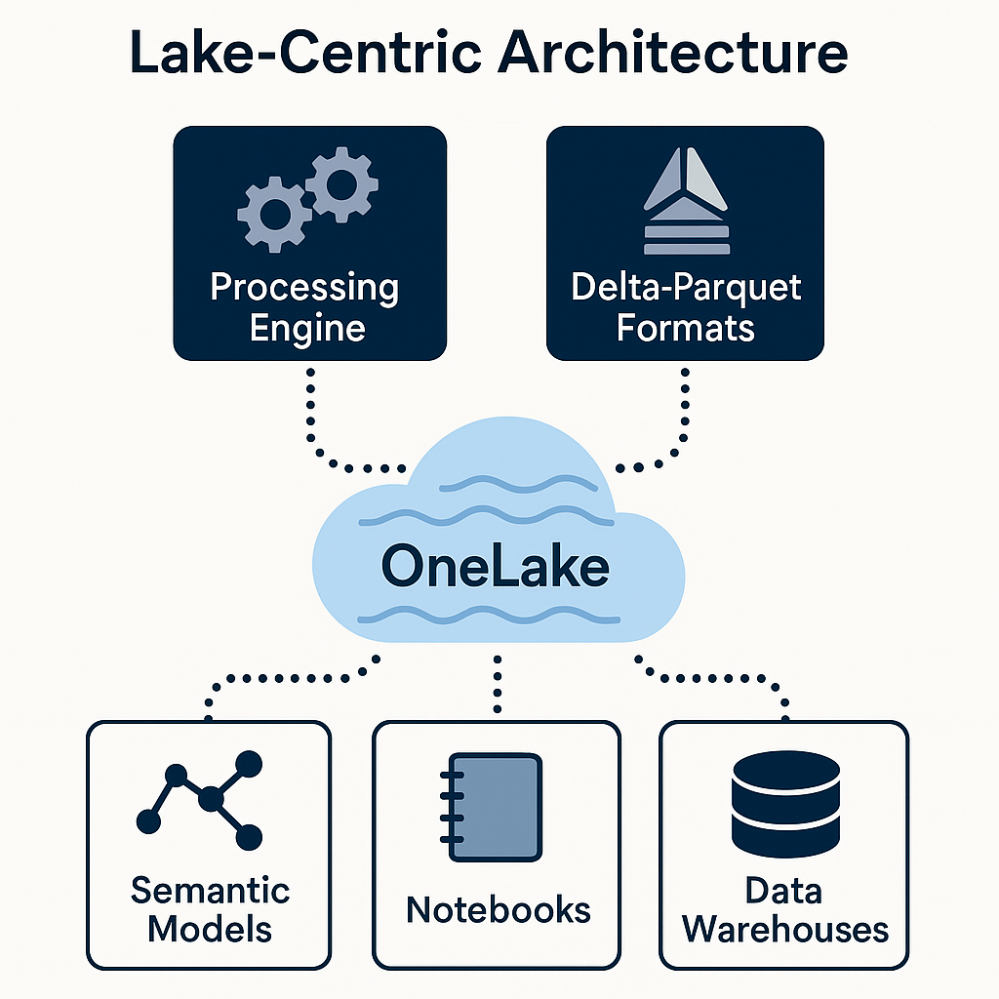
What is a Fabric Data Warehouse?
Lake-Centric Architecture
Built on a distributed processing engine within OneLake
Supports open Delta-Parquet formats which enables ACID transactions and seamless interoperability across Fabric workloads
Notes:
ACID =

Slide 4
What is a Fabric Data Warehouse?
ACID ?
Atomicity - transactions must complete fully or not at all.
Consistency – database is in a valid state before & after transaction. If a transaction violates integrity rules, it is not committed.
Isolation – concurrent transactions do not interfere with each other.
Durability – once a transaction is committed, its effects are permanent and saved to a non-volatile storage.
Notes:
ACID =

Slide 5
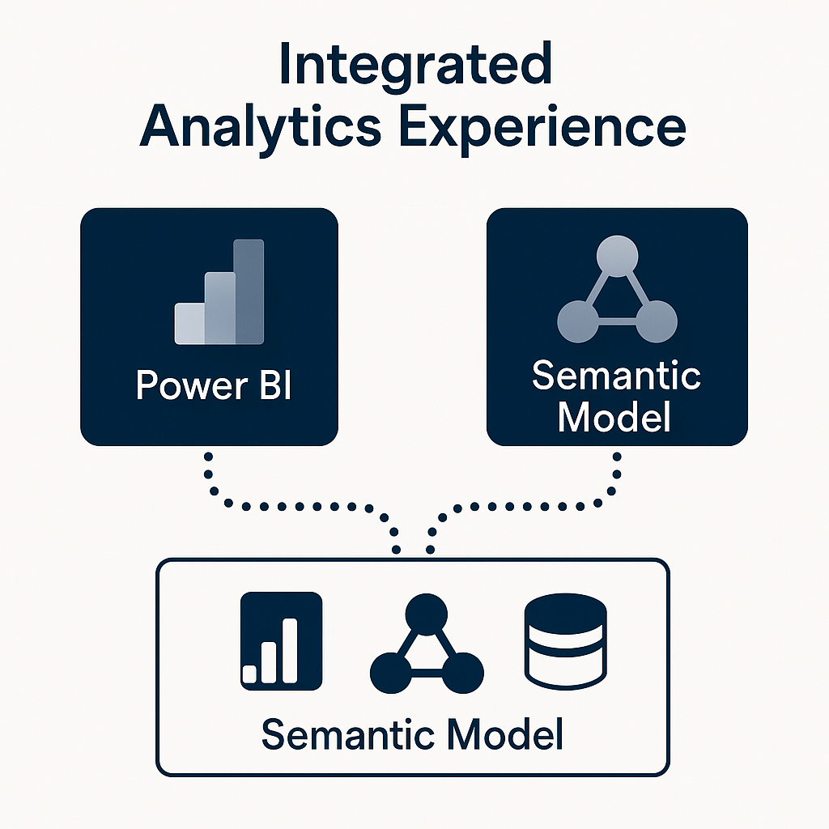
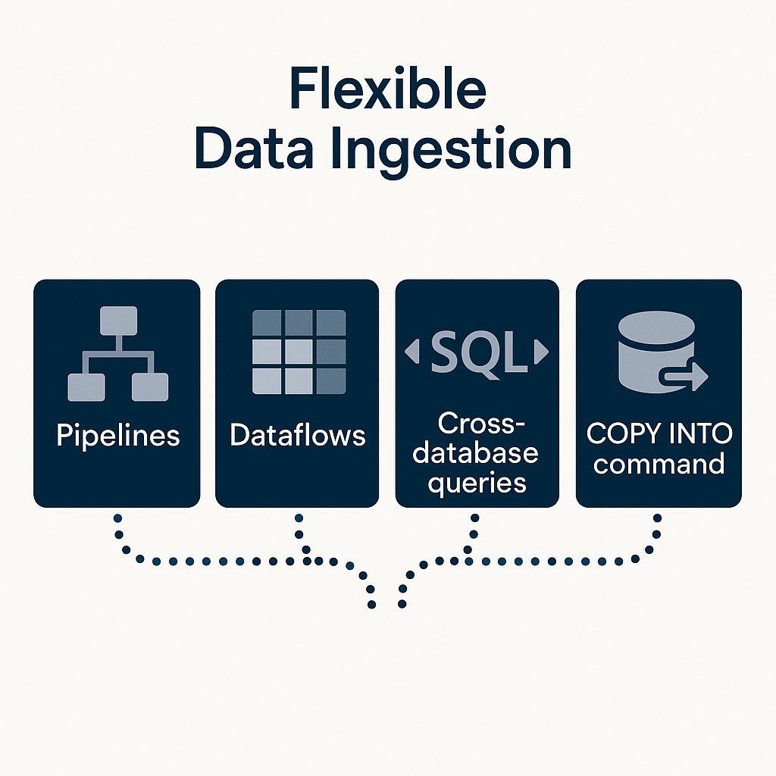
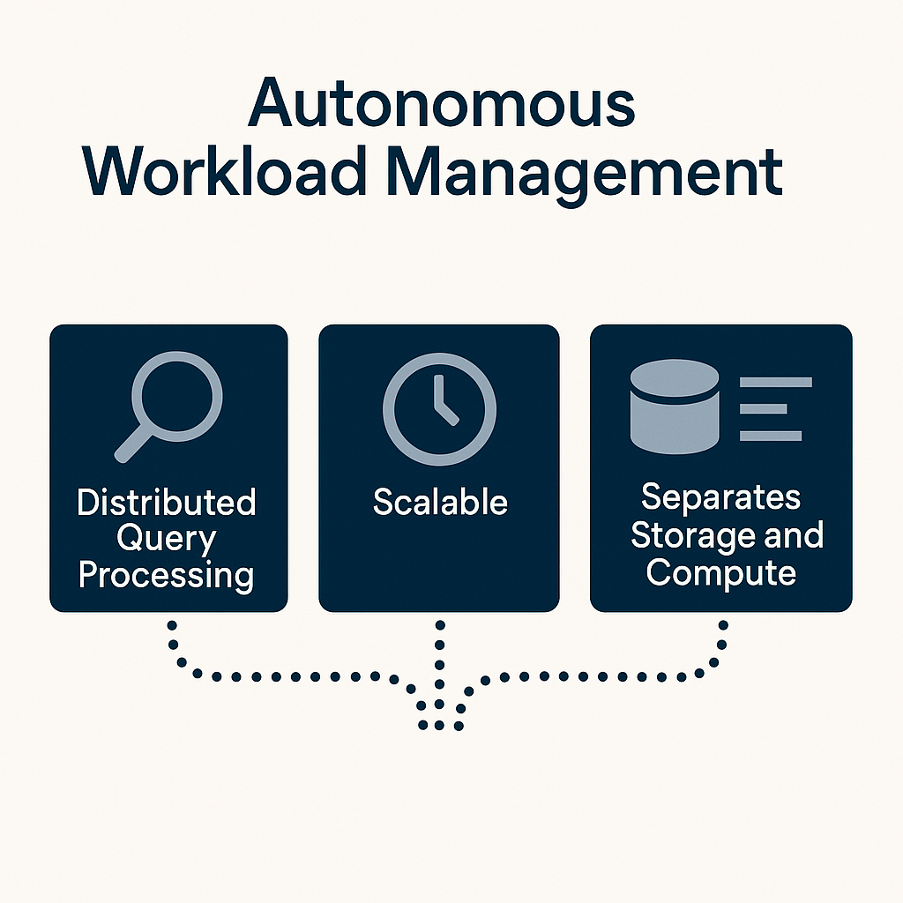
What is a Fabric Data Warehouse?

Slide 6
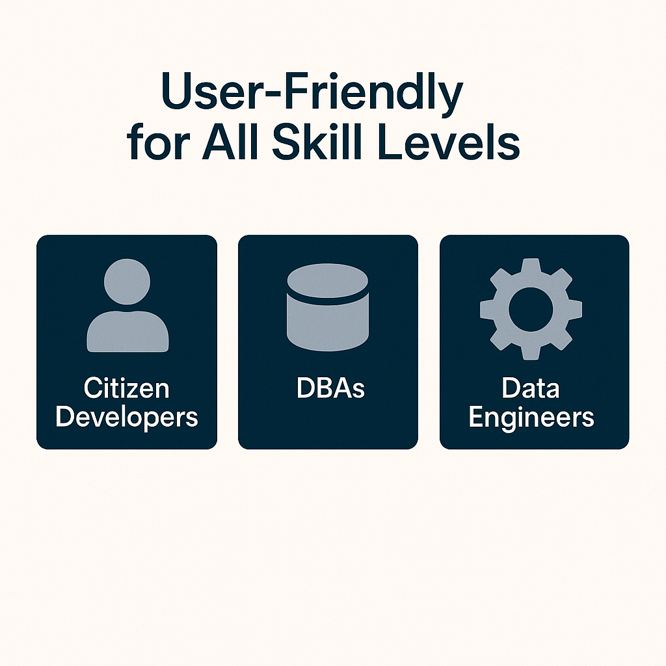
What is a Fabric Data Warehouse?
User-Friendly for All Skill Levels
The Big Selling Point
Designed for a range of users—from citizen developers to DBAs and data engineers—providing an easy-to-use SaaS experience that simplifies data warehousing tasks while offering elements of a deeper customization for more experienced users.

Slide 7

Sounds wonderful so…what’s the Issue?

Slide 8

The Issues
Case Sensitivity (solved!)
Performance Monitoring
Killing Capacity Murderers

Slide 9
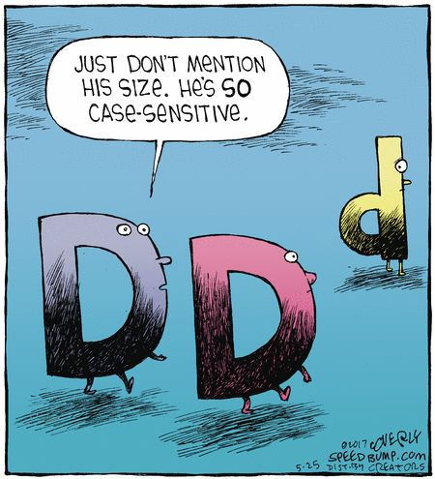
Problem 1 – Case Sensitivity (solved!)
Fabric data warehouses are case sensitive by default which can lead to errors
Solution – utilize the API to create a case-insensitive warehouse.
Important note – you cannot convert a warehouse to be case-insensitive. You must create a new one and port data over to it if necessary.
Notes:
SHOW HOW TO SET UP SERVER REGISTRATIONS IN SSMS

Slide 10

Success Story
As of August, there is a way to set a workspace default collation without a REST API!
Microsoft is always listening, learning, and adapting
Don’t be afraid to speak up and provide feedback, it’s welcomed and encouraged
Notes:
Streamlining Data Management with Workspace Collation Settings in Microsoft Fabric Warehouse and SQL Endpoint | Microsoft Fabric-Blog | Microsoft Fabric

Slide 11

Demo Time!

Slide 12

Problem 2 – Performance Monitoring
Built-in performance monitoring leverage DMVs that can be slow running and fail when capacity is overloaded
Solution – utilize DMVs to build a warehouse monitoring tool that imports data that will still work when capacity is slowing down.
Important note – this solution is best suited to live in a separate capacity (can even be a pro or PPU workspace) so that it doesn’t slow when the capacity gets throttled
Notes:
DMV = dynamic management view

Slide 13

Problem 3 – Killing those Capacity Murderers
Rogue queries can consume excessive resources, potentially crippling warehouse capacity. Unfortunately, the capacity metric app does not contain session IDs necessary to kill long running queries.
Solution – utilize custom monitoring to find session IDs to kill when needed.
Important note – this solution is best suited to live in a separate capacity (can even be a pro or PPU workspace) so that it doesn’t slow when the capacity gets throttled
Notes:
Permissions
An Admin has permissions to execute all three DMVs (sys.dm_exec_connections, sys.dm_exec_sessions, sys.dm_exec_requests) to see their own and others' information within a workspace.
A Member, Contributor, and Viewer can execute sys.dm_exec_sessions and sys.dm_exec_requests and see their own results within the warehouse, but does not have permission to execute sys.dm_exec_connections.
Only an Admin has permission to run the KILL command.

Slide 14


Slide 15

Don’t forget to connect, thanks for listening!
https://dataonwheels.wordpress.com/
kristyna@dataonwheels.com
@data_dragoness
GitHub

